Slide 1
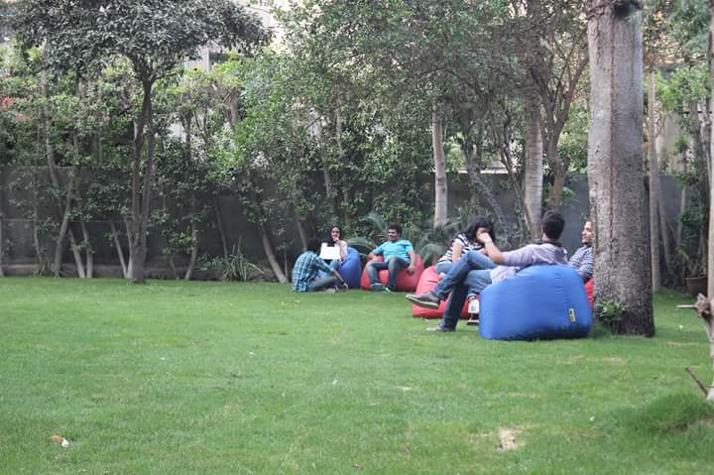
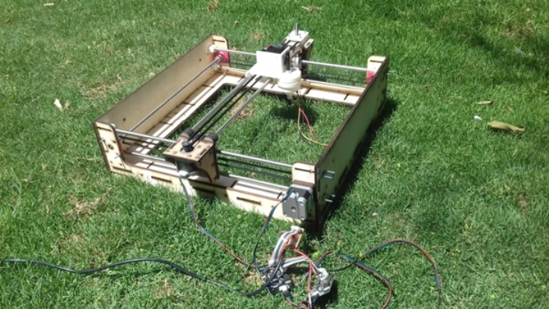
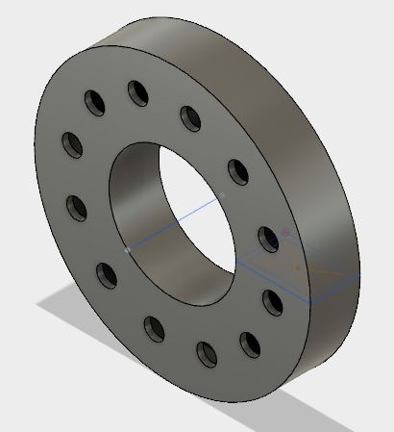
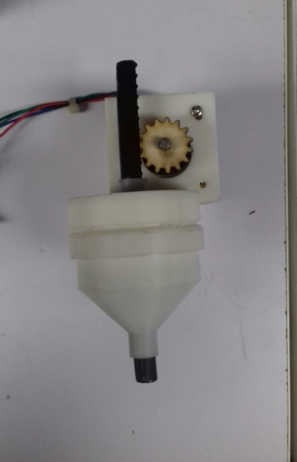
Farming Machine
Features:
Inspired by “Farmbot”, Our Farming machine provides seeding and watering system for your garden.
Tool set:
2D and 3D Design
Laser cutting.
3D printing.
Gestalt​ boards for motors control.

